Slide 1


ZEVA Meeting
Romania - Report
Dr. CARMEN PANTIȘ
Vice-President of the Executive Board of the Romanian College of Physicians, Coordinator of the Professional Jurisdiction Department

Slide 2
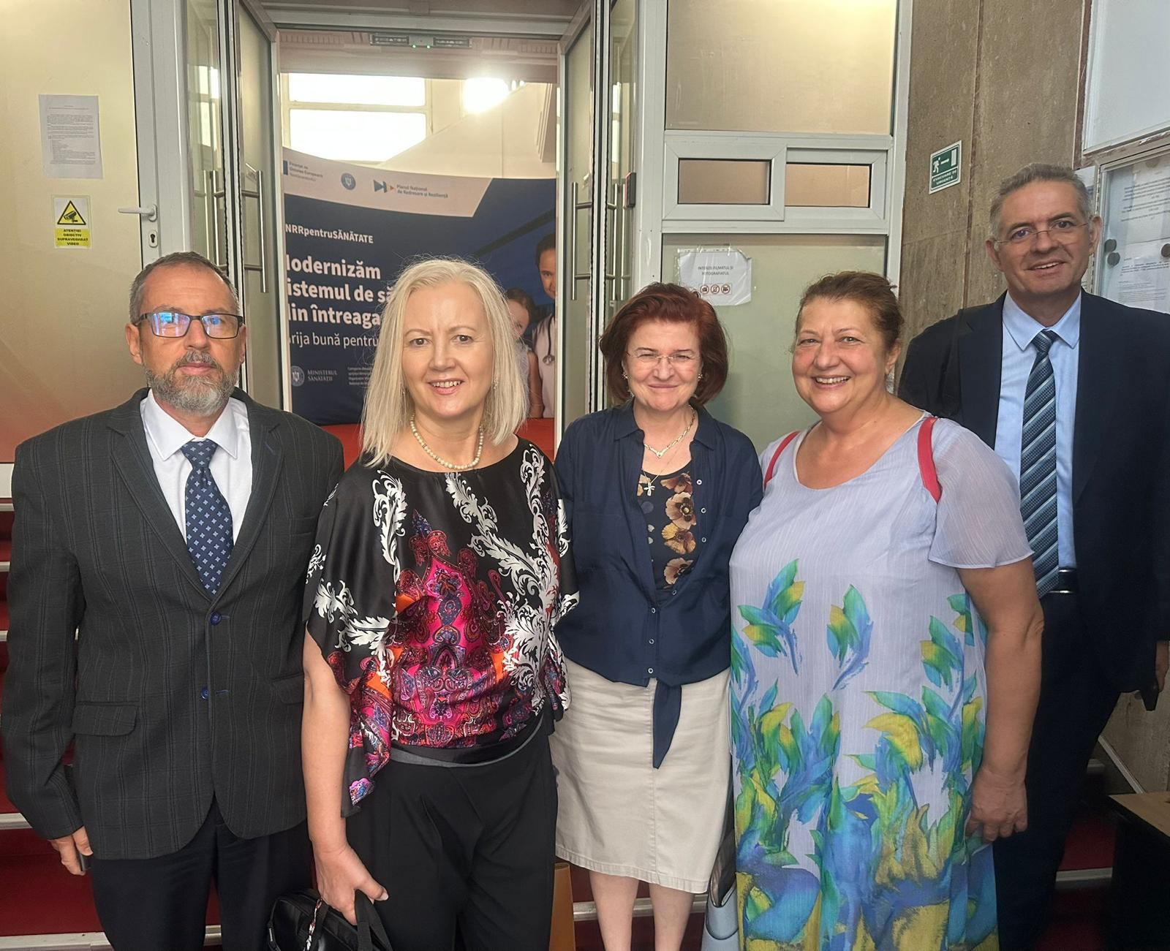

Slide 3
Romania’s integration of AI into medicine is off to an encouraging start, with both real-world pilots and academia-driven advancements paving the way. However, growth is tempered by regulatory uncertainties, low overall AI usage, and concerns from professionals about responsibility and infrastructure.

Slide 4
In just a few years, AI learning systems will be part of everyday medical life, streamlining administrative processes in clinics and practices or supporting doctors in diagnosis and therapy—even taking over some medical tasks.
As of April 2024, Romania’s largest private network of clinics, Regina Maria, began piloting an AI platform called Parol, developed with a Romanian startup. The tool generates real-time medical reports from doctor–patient interactions, simplifying paperwork and enhancing record accuracy. The pilot spanned clinics in Bucharest, Cluj-Napoca, and Timișoara, and plans are underway to expand the system across all their 56 clinics

Slide 5
The European Health Data Space—set to become operational sometime in 2025—will enhance data sharing across the EU. Through this, patient data privacy and interoperability can improve diagnostics, prevention, and personalized care.
In March 2025, researchers proposed a retrieval-based method to automate mapping of medical procedure names in Romanian to standardized insurance codes, using sentence embeddings. This tackles administrative friction in healthcare billing.

Slide 6
AI usage in general across Romanian businesses is low—only around 1.5% of companies utilize AI, compared to much higher adoption rates in countries like Denmark.
There’s no AI-specific law yet in Romania, but frameworks like the EU AI Act, GDPR (via national Law 190/2018), and the AI Liability Directive are being implemented. Romania is also working on a National AI Strategy for 2024–2027 and ethics-oriented regulation like the Deep-Fake Regulation 471/2023.

Slide 7
Just recently, in August 2025, the RoMedQA benchmark launched a dataset of over 102,000 question-answer pairs related to cancer case summaries in Romanian.
It enables testing and refining large language models (LLMs) in clinical reasoning and terminology, showing that fine-tuned models outperform zero-shot ones.

Slide 8
•Does your medical chamber have a developed position on AI?
To date, the RCP has not issued specific public positions on the use of AI, as other European bodies have done, and has not yet issued its own guidelines or policies.
However, in the context of the implementation of the EU AI Regulation (in force from 1 August 2024), we are considering collaborating with competent authorities implementing European standards.

Slide 9
•Do you inform members about the developments in AI, and if so, how?
The ROMANIAN COLLEGE PHYSICIAN has not regularly organized campaigns or materials on AI.
However, in Romania there are accredited courses on digital transformation and AI in healthcare, with the support of partner entities, accredited by RCP itself.
These courses allow healthcare professionals to stay up to date with new technologies.

Slide 10
•Do you anticipate using AI to plan the deployment of medical personnel in your country? What role would your medical chamber play in this process?
There are no public plans by the RCP in this regard yet. However, the administrative domain is becoming digitalized through AI solutions (e.g. platforms such as Parol in the Regina Maria network in Romania). These tools can provide valuable insights for staff planning, but national implementation would require cooperation between state institutions, the Ministry of Health and the RCP.

Slide 11
While AI systems could prove useful in mitigating the foreseeable workforce shortage, it should be recognized that, given the increasing workload and cognitive efforts required from healthcare professionals, there may be a risk of automation bias and overconfidence.
Similarly, such psychological effects could lead to workforce disqualification effects over time, which could prove harmful to patients in situations where AI systems fail or become unavailable.

Slide 12
We support the inclusion of AI training as a critical component of residency training.
This will equip future doctors with the knowledge and skills needed to use AI effectively and ethically.
We also believe that the existing workforce should be further qualified through continuing medical training, and RCP is committed to playing a key role in upskilling the workforce.

Slide 13
The role of the RCP could be:
Professional regulator: assessing the ethical and legal compliance of medical AI systems, in line with the EU AI Regulation and ethical codes.
Training facilitator: providing courses or information sessions for members so that they understand and adopt applicable AI in practice.
Health policy consultant: working with local authorities and academia to develop a strategic framework, aligned with international standards, such as the FUTURE-AI code for trustworthy AI in healthcare.
The RCP advocates for increased integration of AI literacy into medical school and residency training programmes.

Slide 14
Are there any plans for your medical chamber to us AI in its work, e.g. in the area of member administration? Do you already use it?
For now, RCP does not use AI in its internal member administration (e.g. database management, physician registry).
These systems can be adapted from commercial solutions or dedicated developments.

Slide 15
In the private sector, there are examples from Romania: the Regina Maria network uses the Parol platform to automatically generate medical reports, reducing bureaucracy and giving doctors more time for purely medical work.
Also, the Oradea County Hospital is testing AI applications to support diagnosis and treatment plans, but these operate at a local level, not centrally by RCP.
Countless clinical applications could be envisaged for an AI system that can accurately answer questions from medical staff and patients. The impact could be enormous in primary care, where medical staff need to stay up to date with a wide range of medical conditions

Slide 16


Slide 17
THANK YOU FOR YOUR ATTENTION!

