Slide 1


ZEVA Meeting
Romania - Report
Dr. CARMEN PANTIȘ
Vice-President of the Executive Board of the Romanian College of Physicians, Coordinator of the Professional Jurisdiction Department

Slide 2
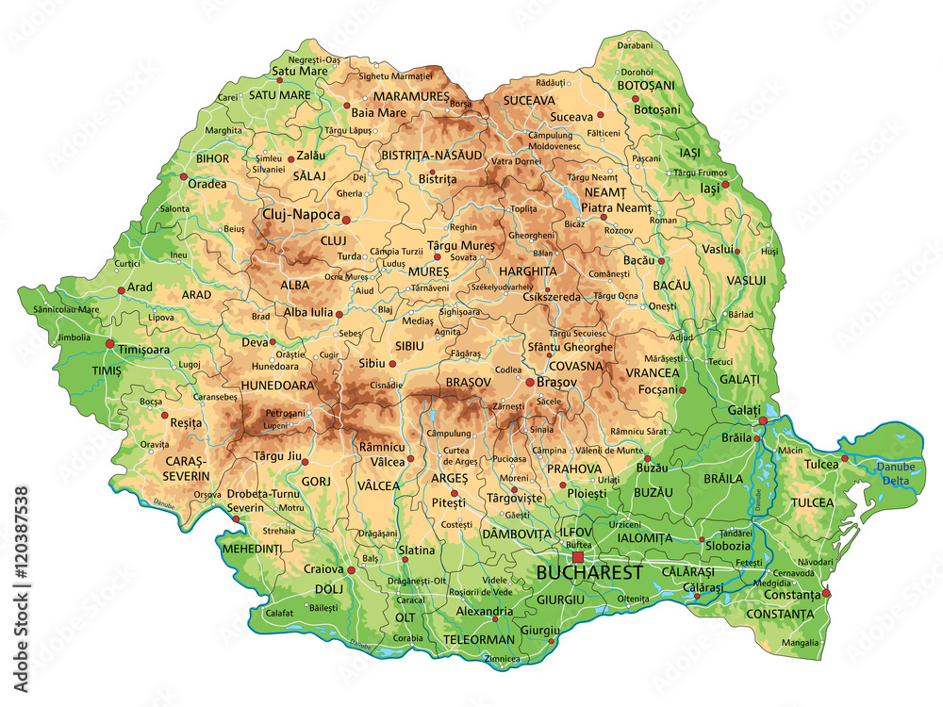

Slide 3
Involvement in planning of medical personnel: Management and development of healthcare personnel (physicians) at the regional level:
How is the planning of medical personnel organized in your country? Are there any tools which facilitate this organization? Are there any bodies that include all the relevant stakeholders, besides the government?

Slide 4
In Romania, medical staff planning is centrally coordinated by the Ministry of Health, in collaboration with other relevant institutions, such as the National Institute of Public Health (INSP), medical universities, but also with professional organizations, including the Romanian College of Physicians.

Slide 5
Planning is based on demographic analyses, on the need for medical services at national and regional levels, as well as on data on the current distribution of doctors by specialty and territory.
There are several tools and databases that support planning:
-The Single Registry of Doctors managed by RCP, which includes information on the specialty, workplace and professional status of each doctor;
-The REVISAL platform, for recording employment contracts;

Slide 6
- The Integrated Health Insurance Information System (SIUI), which provides data on the medical activity carried out;
- Staff needs assessment studies, periodically carried out by the Ministry of Health or by international organizations, such as WHO or the World Bank.
Other stakeholders are also involved in the process of planning and developing human resources in health, through advisory bodies or working groups. Among them:
- The Romanian College of Physicians, as a professional authority;
- Medical universities, involved in initial and continuing training;

Slide 7
- Patient associations, in the context of assessing real needs in the system;
- Local public administrations, especially for regional planning.
• Is your medical chamber involved in the development of medical personnel?
The Romanian College of Physicians plays a key role in the continuous professional development of physicians. It:
-Accredits providers of CME activities, credits CME events and supervises continuing medical education programs;

Slide 8
Participates in the development of policies on professional training and recognition of qualifications;
Supports the decentralization of professional training through collaboration with territorial branches and university centers;
Contributes, through official positions and recommendations, to public policies on mobility, geographical balance and retention of physicians in disadvantaged regions.

Slide 9
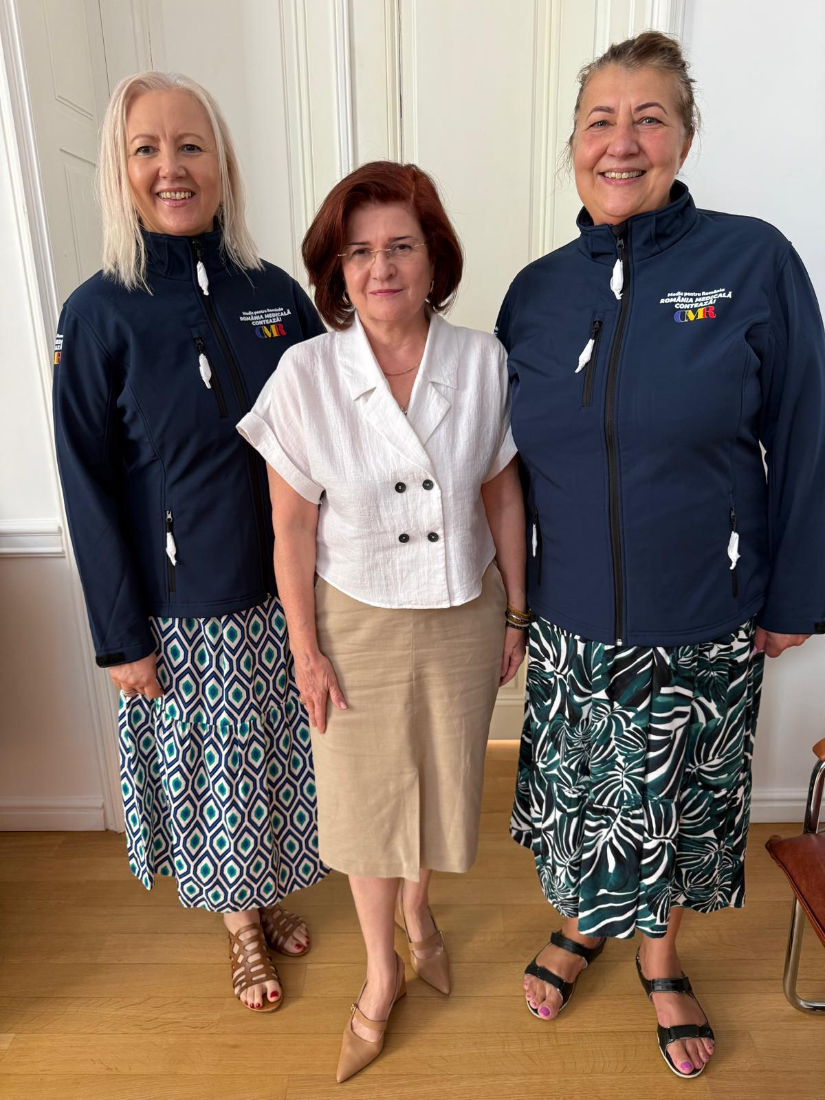
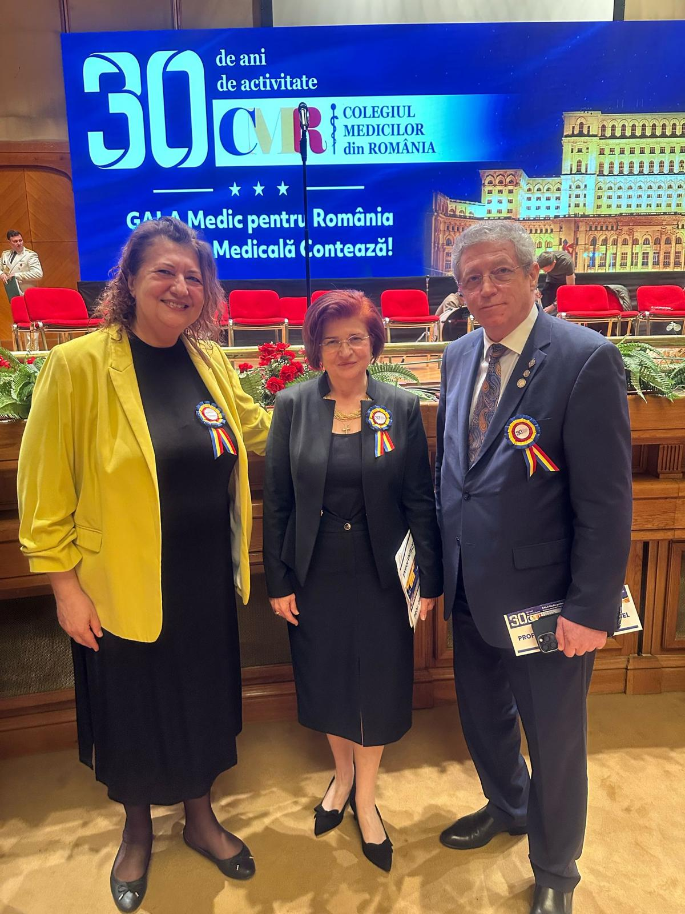

Slide 10
Recognition of foreign diplomas: Which authority in your country is responsible for the recognition of foreign diplomas? Is your medical chamber responsible?
For the recognition of university diplomas issued in other countries, the competent authority in this field is the National Centre for the Recognition and Equivalence of Diplomas (CNRED), which operates as a department within the Ministry of Education.

Slide 11
The procedure for the recognition of a qualification obtained outside the European Union is carried out by the Ministry of Health.
The Romanian College of Physicians is involved in the procedure for the recognition of qualifications obtained in other countries, by issuing an opinion based on the minutes of the Joint Recognition Commissions in which the RCP has 2 members.

Slide 12
Qualifications obtained in the EU are recognized through the automatic mechanism or the general system by the Ministry of Health.
The right to practice is obtained after registration in the Romanian College of Physicians, which in turn is possible only after the equivalence of the university degree by the CNRED and the title of qualification by the Ministry of Health.

Slide 13
THANK YOU FOR YOUR ATTENTION!

