Slide 1
Symposium of
the Central and East European Chambers of Physicians
ZEVA 2025
MICHAŁ MATUSZEWSKI, MD
THE POLISH CHAMBER OF PHYSICIANS AND DENTISTS

Slide 2



I. Artificial intelligence

Slide 3
I. Artificial intelligence
1. Does your medical chamber have a developed position on AI?
The amendment to the Polish CODE OF MEDICAL ETHICS
- May 2024 -
by the General Extraordinary Assembly of Physicians and Dentists

Slide 4
I. Artificial intelligence
1. Does your medical chamber have a developed position on AI?
CODE OF MEDICAL ETHICS
CHAPTER I : Conduct of the physician toward the patient
    Art. 12.
    A doctor may use AI in diagnostic, treatment or prevention proceedings under the following conditions:
    the patient is informed that AI will be used in making a diagnosis or in the therapeutic process;
    informed consent of the patient is obtained for the use of AI
    the AI algorithms used are approved for medical use and certified;
    the final diagnostic and therapeutic decision is always made by the doctor.

Slide 5
I. Artificial intelligence
1. Does your medical chamber have a developed position on AI?
CODE OF MEDICAL ETHICS
Commentary of the Medical Ethics Commission of the Supreme Medical Council
    informing the patient and obtaining their informed consent is required:
    - when the doctor intentionally uses AI, in ways where the AI algorithm plays a key role in the provided service, including performing independently a clinical task, without further involvement or with minimal involvement of the doctor.

Slide 6
I. Artificial intelligence
1. Does your medical chamber have a developed position on AI?
CODE OF MEDICAL ETHICS
Commentary of the Medical Ethics Commission of the Supreme Medical Council
    obtaining an informed consent is not necessary:
    when a doctor uses AI that only assist him in performing his activities, e.g. improving the quality of imaging data, supporting the doctor's diagnostic description, etc.
    - it is recommended to inform the patient about the technologies used in this process.

Slide 7

I. Artificial intelligence
2. Do you inform members about the developments in AI, and if so, how?

Slide 8
I. Artificial intelligence
2. Do you inform members about the developments in AI, and if so, how ?
NIL IN - Community of Physicians Innovators
The network is an initiative of the Polish Chamber of Physicians and Dentist and was created as part of the Central Research, Innovation and Education Centre - COBIK of the PCPD.
Its goal is to create a common space for doctors interested in and engaged in medical innovations.
The project aims to facilitate collaboration and partnerships, organize tools, and help provide essential knowledge and support to doctors interested in innovation in the field of medicine.

Slide 9
I. Artificial intelligence
2. Do you inform members about the developments in AI, and if so, how ?
Working Group on Artificial Intelligence
– established in 2023
Mission:
Creation of a forum for the exchange of knowledge and experiences regarding the applications of AI in medicine – through regular meetings with experts from Poland and abroad, as part of joint publications and research projects.
To seek implementation of algorithms that support decision-making processes, which are valuable for patients, medical staff, and the Polish healthcare system.

Slide 10
I. Artificial intelligence
2. Do you inform members about the developments in AI, and if so, how?
Working Group on Artificial Intelligence
Goal: to transform local experiences not only for the health of our patients but also to elaborate guidelines for the Polish NHS for the justification of funding AI in clinical practice. to develop recommendations for international standards for evaluating AI based on Polish experiences.

Slide 11
I. Artificial intelligence
2. Do you inform members about the developments in AI, and if so, how?
Activities in the field of AI:
Conferences:
• „European Medical Data Space and Artificial Intelligence” – 2022 – organized by COBIK, Polish Chamber of Physicians and Dentists;
• „AI & MEDTECH” – 2022, 2023, 2024, 2025 - bringing together leaders, experts and specialists in the field of medical innovation to discuss key topics related to new technologies and latest advances in the Polish and international healthcare sectors.
• „The European Health Data Space – A Challenge for Europe. Implementing Solutions in the Age of AI, Big Data, and Personalized Medicine”– co-organized by the Polish Chamber of Physicians and Dentists – Medical University of Warsaw

Slide 12
I. Artificial intelligence
2. Do you inform members about the developments in AI, and if so, how?
COBIK-NIL IN activities in the field of AI:
Examples of conducted trainings for physicians:
• „AI - practical applications of publicly available artificial intelligence tools”
• „How to use AI safely - the protection of personal data in innovations”
• „AI in everyday pulmonology practice”

Slide 13
I. Artificial intelligence
3. Do you anticipate using AI to plan the deployment of medical personnel in your country? What role would your medical chamber play in this process?
The deployment of medical personel in Poland by means of AI is not envisaged.
By keeping data on the number of doctors the Polish Chamber of Physicians and Dentists is able to monitor and indicate by means of AI eg. the voivodeships with the highest average age of doctors and the risk of staff shortages.

Slide 14
I. Artificial intelligence
4. Are there any plans for your medical chamber to us AI in its work, e.g. in the area of member administration? Do you already use it?
The administration staff of the Polish Chamber of Physicians and Dentists checks and benefits from content delivered by ChatGPT /CO Pilot in its daily work.

Slide 15



II. New generations in the medical chambers
MICHAŁ MATUSZEWSKI, MD
THE POLISH CHAMBER OF PHYSICIANS AND DENTISTS

Slide 16
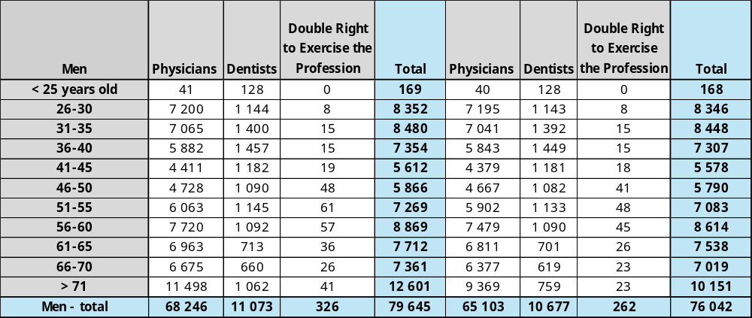
II. New generations in the medical chambers
1. What is the age distribution of your members?

Slide 17
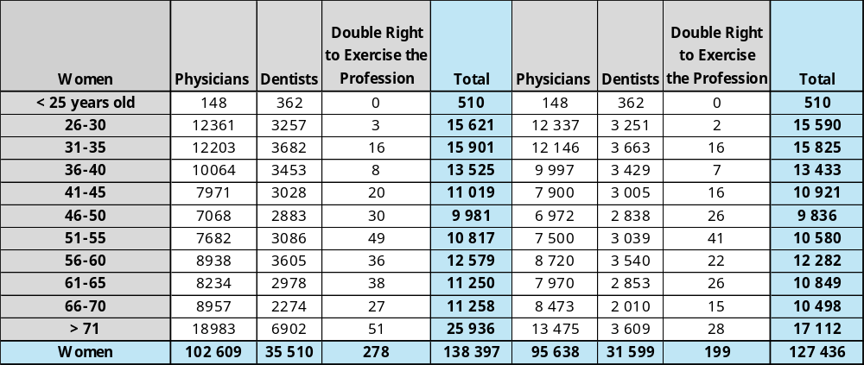
II. New generations in the medical chambers
1. What is the age distribution of your members?

Slide 18
II. New generations in the medical chambers
2. Do you have any numbers on the age of your medical chamber’s leadership (Executive board, General Assembly etc.)?
The Polish Chamber of Physicians and Dentists:
the Presidium of the Supreme Medical Council - average age: 50
the Supreme Medical Council - average age : 53
Only 6 physicians/dentists are of less than 35 age old – out of 75 members of the Supreme
Medical Council

Slide 19
II. New generations in the medical chambers
3. Are there concepts, either concrete or planned, to encourage young doctors to become involved in the work or bodies/committees of your medical chambers? If so, what are these concepts?
Commission for Junior Doctors
- at the Polish Chamber of Physicians and Dentists (national level)
- at the Regional Medical Chambers
Kick-off meetings - training and integration events for graduates of medical universities – at the Regional Medical Chamber of Warsaw

Slide 20
II. New generations in the medical chambers
4. How many young people in your country are interested in studying medicine each year? How many of these individuals end up studying medicine? What role does your medical chamber play in encouraging young people to study medicine?
For the 2025/2026 academic year, the Ministry of Health proposes (the regulation has not yet been finally adopted) the following admission limits for medical studies in Poland:
The total admission limit is 10,249 places, including:
- 6,649 places for uniform Master's degree programs conducted as full-time studies in Polish for Polish citizens and foreigners,
- 1,712 places for uniform Master's degree programs conducted as part-time studies in Polish,
- 1,888 places for uniform Master's degree programs conducted as full-time or part-time studies in a language other than Polish.

Slide 21
II. New generations in the medical chambers
4. How many young people in your country are interested in studying medicine each year? How many of these individuals end up studying medicine? What role does your medical chamber play in encouraging young people to study medicine?
Due to the high popularity of medical studies and the high number of candidates each year (including for paid studies), the Polish professionnal self-government of Physicians and Dentists does not undertake any additional activities to encourage people to study medicine.
In short:
6,649 places for unpaid studies and
3,600 places for paid studies (1,712 places for studies conducted in Polish and 1,888 places for studies conducted in English).

Slide 22
II. New generations in the medical chambers
What role does your medical chamber play in encouraging young people to study medicine?
Due to the high popularity of medical studies and the high number of candidates each year (including for paid studies), the Polish professionnal self-government of Physicians and Dentists does not undertake any additional activities to encourage people to study medicine.

Slide 23


III. Involvement in planning of medical personel.
Management and development of healthcare personnel (physicians) at the regional level
MICHAŁ MATUSZEWSKI, MD
THE POLISH CHAMBER OF PHYSICIANS AND DENTISTS

Slide 24
III. Involvement in planning of medical personel.
Management and development of healthcare personnel (physicians) at the regional level
•
1. How is the planning of medical personnel organized in your country? Are there any tools which facilitate this organization? Are there any bodies that include all the relevant stakeholders, besides the government?
    In Poland the medical staff planning is carried out mainly by government institutions – in particular the Ministry of Health – in cooperation with the Medical Centre for Postgraduate Education and national consultants.

Slide 25
III. Involvement in planning of medical personel.
Management and development of healthcare personnel (physicians) at the regional level
•
2. Is your medical chamber involved in the development of medical personnel?
The Polish Chamber of Psysicians and Dentists and the Regional Medical Chambers play an important role in the professional development of physicians, including by:
    supporting and monitoring continuing medical education
    organizing training courses and conferences to promote knowledge and the exchange of experiences;
    organizing postgraduate internship courses

Slide 26


IV. Recognition of foreign diplomas.
MICHAŁ MATUSZEWSKI, MD
THE POLISH CHAMBER OF PHYSICIANS AND DENTISTS

Slide 27
IV. Recognition of foreign diplomas - recognition of qualifications obtained in non- EU/EEA states
Which authority in your country is responsible for the recognition of foreign diplomas? Is your medical chamber responsible?
    Background
    A medical diploma awarded outside the European Union has to be recognized in Poland as equivalent to a medical diploma awarded in Poland.
    The recognition is taking place in a procedure of nostrification at a chosen Medical University in Poland or by taking an exam called LEW (Lekarski Egzamin Weryfikacyjny).
    Nostrification is a comparison of the curriculum of the studies completed abroad and the Polish curriculum in order to check whether they are equivalent. A positive decision on recognition of the foreign diploma may be subject to a requirement for the applicant to complete some training courses or to pass some examinations.
    Since 2021 there is also a new exam which is an alternative to the procedure of nostrification. It is called LEW (Lekarski Egzamin Weryfikacyjny) which is carried out by Centre of Medical Examinations (Centrum Egzaminów Medycznych).

Slide 28
IV. Recognition of foreign diplomas - recognition of qualifications obtained in non- EU/EEA states
Which authority in your country is responsible for the recognition of foreign diplomas? Is your medical chamber responsible?
    To be granted the right to practice the profession a holder of a medical diploma recognized as equivalent (through nostrification or LEW exam) has to fulfil two additional requirements, namely:
    - complete an obligatory 1-year post-graduate internship (staż podyplomowy);
    and
    - pass the Final Medical Exam (Lekarski Egzamin Końcowy, LEK) – the LEK exam may be taken only after the non-EU diploma is recognized in Poland as equivalent through the nostrification or the LEW exam.

Slide 29
IV. Recognition of foreign diplomas - recognition of qualifications obtained in non- EU/EEA states
Which authority in your country is responsible for the recognition of foreign diplomas? Is your medical chamber responsible?
    To commence the postgraduate internship in Poland a graduate applies to the Regional Chamber of Physicians and Dentists for a “Right to practice the profession of a physician awarded in order to complete the internship”.
    If a doctor has completed an internship abroad equivalent to the postgraduate internship that is in place in Poland, one should apply to the Minister of Health for recognition of the internship completed abroad as equivalent to the internship in Poland.

Slide 30
IV. Recognition of foreign diplomas - recognition of qualifications obtained in non- EU/EEA states
Which authority in your country is responsible for the recognition of foreign diplomas? Is your medical chamber responsible?
The LEK exam is organized and carried out by the Centre of Medical Examinations in Łódź (Centrum Egzaminów Medycznych). It is in form of a test consisting of 200 questions. Positive result of the LEK exam is reached with minimum 56% of points.

