Slide 1
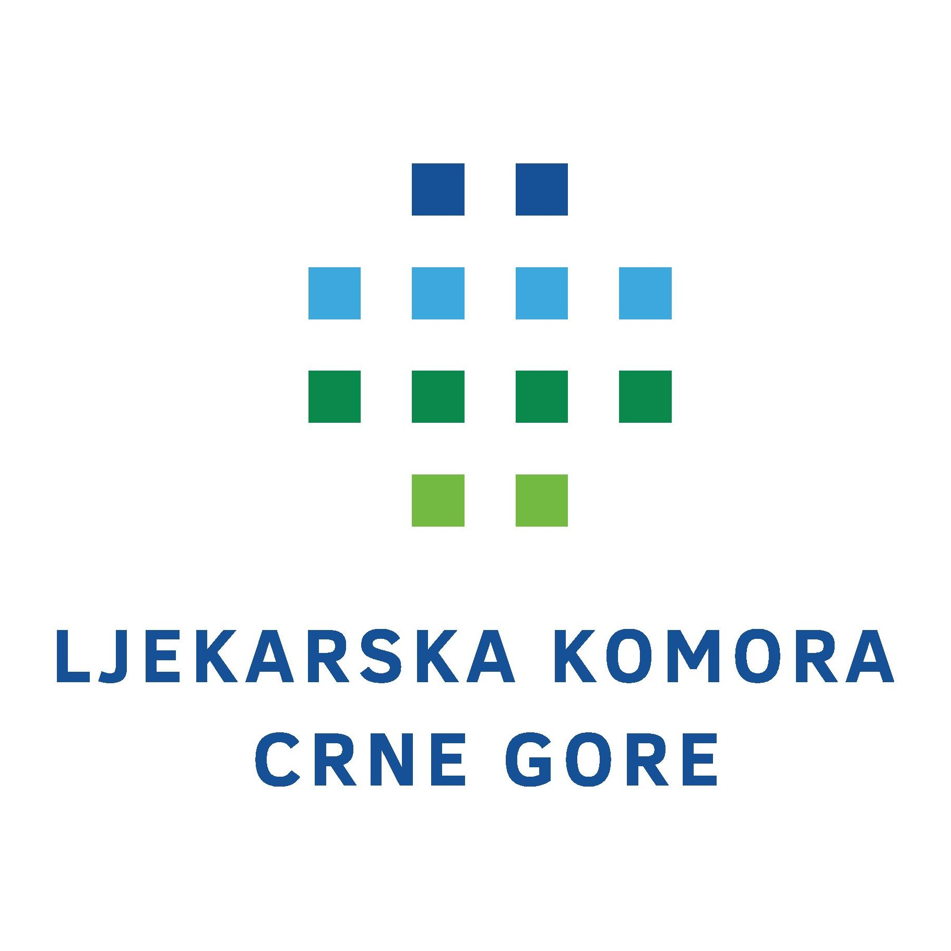


New Generations in the Medical Chambers - Montenegro
Pavle Femić
MD, Pediatric Resident,
Delegate in the Medical Chamber of Montenegro,
President of the Committee of Young Doctors in the Medical Chamber
04-06. 09. 2025.
Skopje

Slide 2
New generations in the Medical Chamber – role and importance
In order to involve young doctors as much as possible in the work of the Medical Chamber, the Committiee for Young Doctors was formed in 2021.
The committee consists of the president, vice president and five members
The basic lines of action of the commission are:
  It keeps records of the number of graduated medical students and young doctors
  Considers drafts and proposals of laws, as well as initiates the adoption of legal and bylaws related to the position of young doctors in Montenegro
  Status of young doctors in Montenegro
  Gives recommendations for education and professional development of young doctors

Slide 3
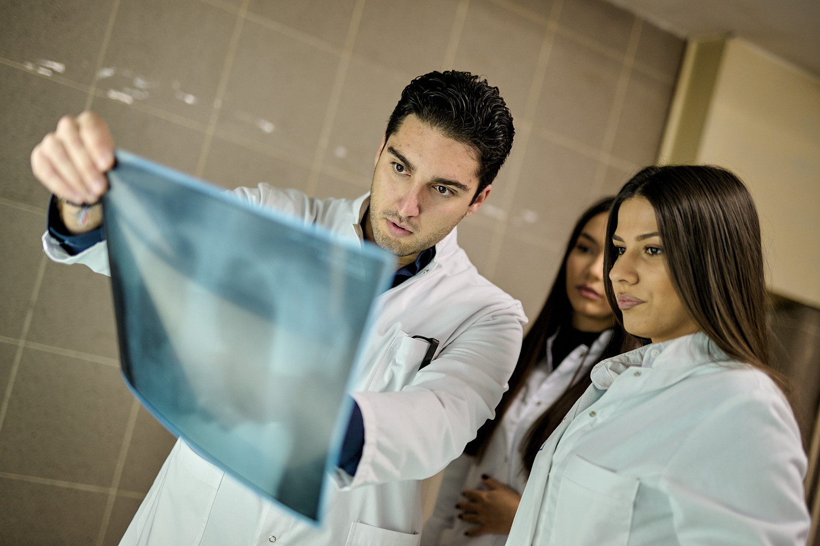
Graduated medical students in Montenegro
The number of graduated medical students (doctors of medicine) at the Faculty of Medicine of the University of Montenegro, who mostly stay to work in the public health of Montenegro, is:
  In 2022 - 36 students
  In 2023 - 31 students
  In 2024 - 42 students
Number of graduated medical students
(doctors of medicine) at medical faculties
outside of Montenegro who will work in
public health Montenegro - we have no records
https://www.ucg.ac.me/med

Slide 4
Young doctors in Montenegro
Young doctors - doctors of medicine who have been working for up to 5 years and/or doctors of medicine up to 35 years of age and/or residents
2795 doctors in Montenegro
  383 young doctors
  2412 others (double-edged sword)

Slide 5
Young doctors in the structures of the Medical Chamber of Montenegro
The structure of the Medical Chamber of Montenegro consists of:
  President of the Medical Chamber
  Executive Board
  Assembly of the Medical Chamber
  Standing Committees (7)
  Supervisory Board
  Court of the Medical Chamber
Of the 121 members who are actively involved in the structures of the Medical Chamber, 9% are young doctors

Slide 6
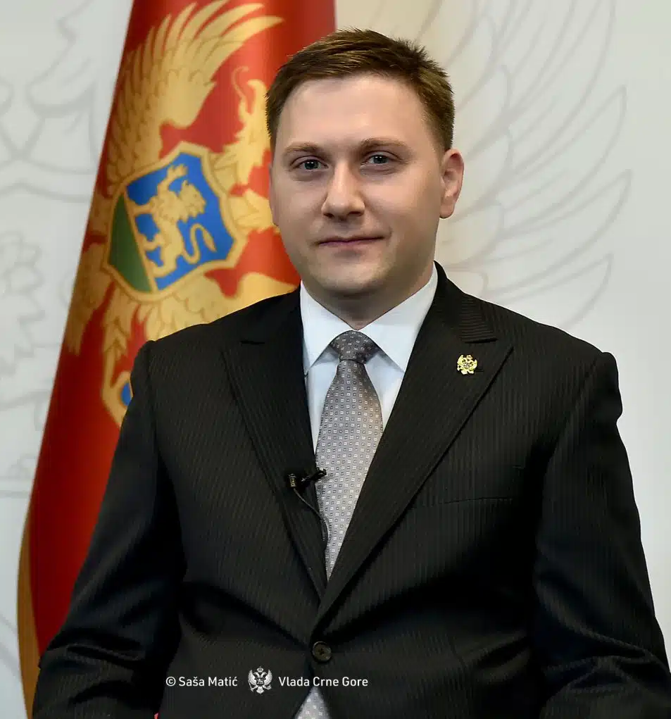
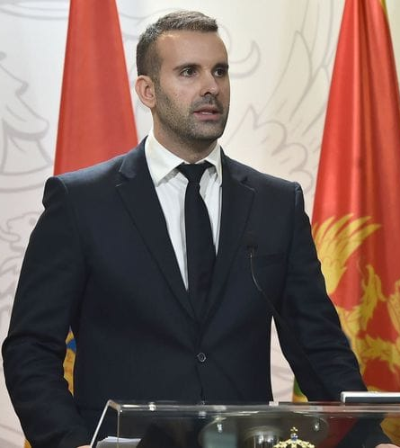
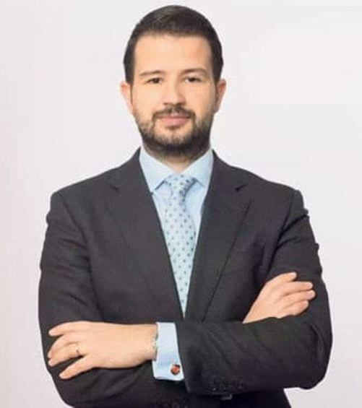
37 years old
37 years old
38 years old

