Slide 1

Application of artificial intelligence in the Montenegrin Medical Chambre
Prof. Dr Vesna Miranović
Clinical Centre of Montenegro
Medical Faculty,
University of Montenegro
Notes:
Artificial intelligence (AI) is increasingly transforming healthcare delivery and the roles of medical institutions. Medical associations and regulatory bodies around the world are exploring how AI can augment (augment) core functions – from physician licensing (lajsensing) and education to ethical oversight and quality assurance. Medical associations common goal is to ensure that AI in healthcare is “trustworthy”. Medical associations are thus developing policies and strategies to harness AI’s potential in a manner consistent with professional ethics, patient safety, and public trust.

Slide 2

Benefits of using AI
Machine learning refers to the study of the computer systems that learn and adopt automatically, from experience, without being explicitly porogrammed
AI uses computer science and data to enable problem solving in machines
Capacity of AI?
Expectancy from AI?
Analyzes huge amounts of medical data
Recognizes patterns that people miss
Processing speed
Consistency
The ability to "learn" from an increasing amount of data
Predicts risks for disease development
Early detection of disease
Personalized ("precision") therapy
Motivating and educating patients
Deep learning is a machine learning technique that layers of algorithms and computing units- or neurons- into artificial neural networks that mimic human brain

Slide 3




Slide 4



Red flag alarm
Chronic non-communicable diseases (NCD) are the cause of death in 74% of cases
Cardiovascular diseases are the most numerous, accounting for 42% of the total number of deaths
13% are obese, 39% are overweight
NCD 95% of deaths
Cardiovascular diseases 58% of deaths
25% are obese, 60% are overweight
200 000 citizens are smoking (1/3)

Slide 5

CONCERNS
71% of them believe that the introduction of AI will increase the legal liability of doctors in the event of an error
Requires clear legal guidelines on the distribution of liability
94% of associations expressed concern about the ethical implications of AI in medical practice
72% of medical associations believe that the benefits of AI in healthcare outweigh the risks
Consensus that a better understanding and management of these risks is needed
CHALANGES
Over 70% of associations participate in the creation of policies or guidelines related to AI in healthcare
Less than 25% are involved in the actual design or development of the AI tools
70% of respondents emphasize that the role of doctors will remain central despite automation
74% of medical chambers cite limited access to quality data and insufficient infrastructure as significant barriers to the integration of AI in healthcare systems
OECD (2024). Artificial intelligence and the health workforce: Perspectives from medical associations on AI in health. OECD Health Working Papers, No. 149.
No association believes that "AI will replace doctors" or that its impact will be insignificant - all of them predict significant changes, but while retaining the key role of humans
Notes:
Even though AI technology is essential to us, the issue of trust in AI technologies among healthcare professionals and patients is a challenge. OECD research shows that doctors have mixed feelings – enthusiasm about the potential benefits, but also concerns about the accuracy (akjurasi) of AI tools and their integration into existing workflows.
The results showed general optimism with a dose of caution (koušn). Interestingly, no association believes that "AI will replace doctors" or that its impact will be insignificant - all of them predict significant changes, but while retaining the key role of humans.
Also, technical and organizational obstacles were identified as a serious challenge. In other words, without a digitally "mature" infrastructure, the potential of AI may remain untapped.

Slide 6

AMA: most recent survey (2024) showed increase in the use of AI among US physicians – 66% which is almost double the year before
Medical Associations activities about AI using all around the world
The American Medical Association (AMA) adopted principles for "augmented intelligence" in medicine in 2018, updated the guidelines in 2024 based on new experiences. The AMA supports AI that improves care and medical practice, but safety and efficacy be proven through rigorous testing before widespread use.
This example illustrates the chamber's proactive role in protecting the quality of care: while technology promises to relieve bureaucracy, the professional organization warns against pushing the boundaries of safety and ethics.
In 2024, the British Medical Association (BMA) published a document on principles for AI in healthcare. The BMA insists that the introduction of AI must be based on four key principles: safety, efficiency, ethics and fairness (equality).
American Medical Association – Austin Littrell (2025). New AMA report highlights physician optimism about AI in health care. Medical Economics, Feb 19, 2025.
British Medical Association (2024). Principles for artificial intelligence (AI) and its application in healthcare. BMA policy report, updated 1 Oct 2024.
Notes:
National medical associations also formulate specific policies. The American Medical Association (AMA) adopted the principles for "augmented intelligence" in medicine in 2018, and updated the guidelines in 2024 based on new experiences. Also, the AMA is actively taking the pulse of its membership on AI: their latest survey at the end of 2024 showed a sharp increase in the use of AI among American physicians - 66% of the physicians surveyed said they used some AI tool in their practice during 2024, which is almost double the number of the year before.
British Medical Association is an example that illustrates the chamber's proactive role in protecting the quality of care: while technology promises to relieve bureaucracy, the professional organization warns against pushing the boundaries of safety and ethics.

Slide 7
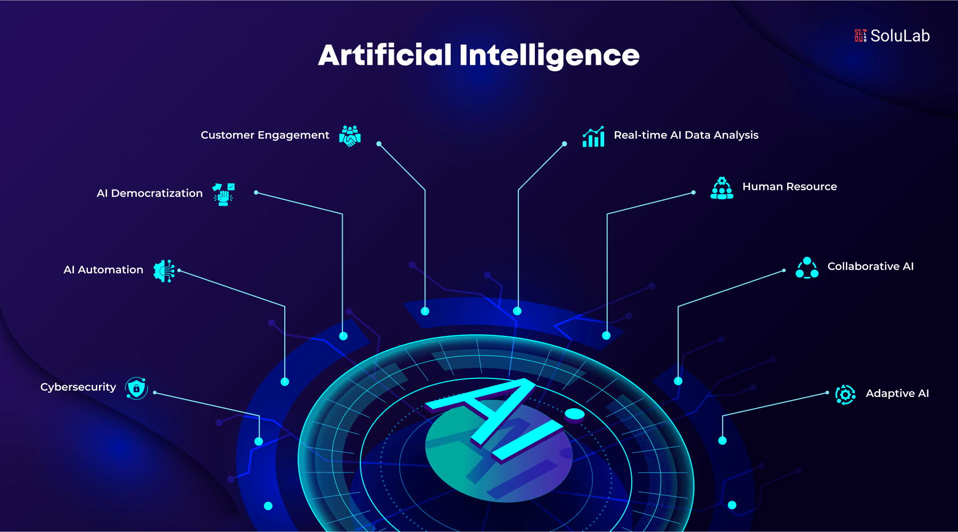

What do we have?
What are we missing?
Digitalization of the health system in Montenegro is ongoing
Strategy of Digital Transformation of Montenegro 2022-2026
Complete digitalization of the system
Legislation for the use of AI in healthcare
AIHeal project enables the creation of a "digital double" of a patient, using data from various sources – from sensors to electronic health records
Disadvantages
Advantages
A small, uncomplicated healthcare system suitable for implementing AI
Solution:Implementation of world-proven AI solutions with fine tuning in relation to the population of Montenegro
Small amount of data for AI training

Slide 8

Montenegrin Medical Chambre AI Principals
To ensure that AI serves as a tool to improve treatment and not as a source of new risks
Education on AI for physicians and regulators
Maintaining human accountability in care
Ensuring informed consent and data privacy when AI is used
Grounding AI governance in core medical ethics
Addressing liability and legal questions
Collaborating with technical experts
Notes:
Montenegrin Medical Chambre is at the very bigining of the trip. For Montenegro, the entry of AI into healthcare is an opportunity to jump a few steps and catch up with more advanced systems, but it requires a strategic vision and careful management. Even the greatest was once a beginner, so we have a
possibility to colect otherʼ s experience and choose the best practices.
The principles by which the Montenegrin Medical Chamber will be guided in the application of AI are: pročitati sa slajda
And another thing that is not on the slide: about records: Montenegrin Medical Chambre should connect with the Faculty of Medicine (the only one in Montenegro) to monitor valuable data important for personnel planning (outflow of personnel educated in Montenegro, return to Montenegro of personnel educated abroad)

Slide 9

EDUCATION
Doctors must familiarize themselves with concepts of algorithmic bias, model validation, etc., in order to critically evaluate the recommendations that AI offers them during decision-making.
Chamber will strive to make training accessible and relevant, emphasizing to physicians that the goal of AI is not to take away their work, but to take over routine tasks and allow them to devote more time to more complex aspects of patient care
Continuous education of doctors about artificial intelligence stands out as one of the most important tasks of Montengrin Medical Chambre
Medical chamber will develop trainings where doctors can practically try out AI tools (e.g. clinical decision systems) in controlled conditions, learning how to interpret them correctly and to be careful
All this requires changes in the organization of work, which Medical chambre can advocate in health institutions and authorities
Notes:
Continuous education of doctors about artificial intelligence stands out as one of the most important tasks of medical chambers in the era of digitization –in order to effectively use AI tools and understand their limitations, possibilities and implications.
Taking into account character of the doctors, education is very important. As someone who introduced electronic scheduling (skedjuling) in Montenegro, I was convinced that introduction of new technology is often met with skepticism by healthcare professionals. Doctors and nurses are already overloaded with obligations, so any additional complexity may be met with resistance. If an AI tool is not user-friendly and clearly useful, there is a risk that staff will ignore it. The key is therefore user-oriented design and training. The use of AI tools should be made as intuitive as possible – ideally (ideali) to fit into existing work habits.

Slide 10

The sequence of steps in the operation of the Montenegrin Medical Chamber
2. Improving health information and data quality
Standardization of electronic health records at the primary level, structured records, which will enable data collection for AI analyzes and national registries for major chronic diseases automatically colected from primary and secondary healthcare
Defining procedures for safe use of de-identified data for research and AI purposes ("data warehouse„)
Strategic approach to digitization and AI in healthcare
- Creation of a National strategy for the application of AI in the health system with mapping of priority areas.
Address the legal framework: updating the law to define the use of AI as a medical device (eg alignment with the EU AI Act), and clearly regulate issues of responsibility and ethics.
4. Involvement of patients and the public, Cooperation with the academic and innovative sector
3. Establishing ethical and supervisory bodies for AI in healthcare
- Forming a special expert-ethical commission at the Ministry of Health/Montenegrin Medical Chamber in order to assess of AI systems before implementation and monitoring their performance.
- Establishing a system for reporting errors or incidents related to AI.
5. Stage of gradual implementation and scaling of successful solutions
Notes:
Within the framework of the strategy, Montenegro should rely on international frameworks and partnerships - e.g. alignment with the EU AI Act), and clearly regulate issues of responsibility and ethics.
Involving patients in the process: Ultimately, the goal is to create a sense among the public that AI in healthcare is something that is done “with them and for them,” and not something that is imposed on them.
Establishing of a system for reporting errors or incidents related to AI (similar to what exists for drugs and medical devices)
Medical associations will strive to provide their membership and the healthcare system with the tools and knowledge to use AI for the benefit of patients, while preserving the core values of medicine – humanity, compassion, trust and ethics.

Slide 11

Hall 9000 to Dave:“I’m sorry, Dave, I’m afraid I can’t do that“.”
Stanley Kubrick,
„2001: A Space Odyssey“, 1968
Notes:
At the end, the heartbreaking scene in Cubric s masterpiece, in which Hall refuses to obey and decides to sacrifice the human crew (kru) to make the mission succeed, serves as a small reminder of how cruel a machine can be.

