Slide 1


Doctor’s chamber of republic of north Macedonia

Slide 2


  New generations in the medical chambers

Slide 3

What is the age distribution of your members?

Slide 4

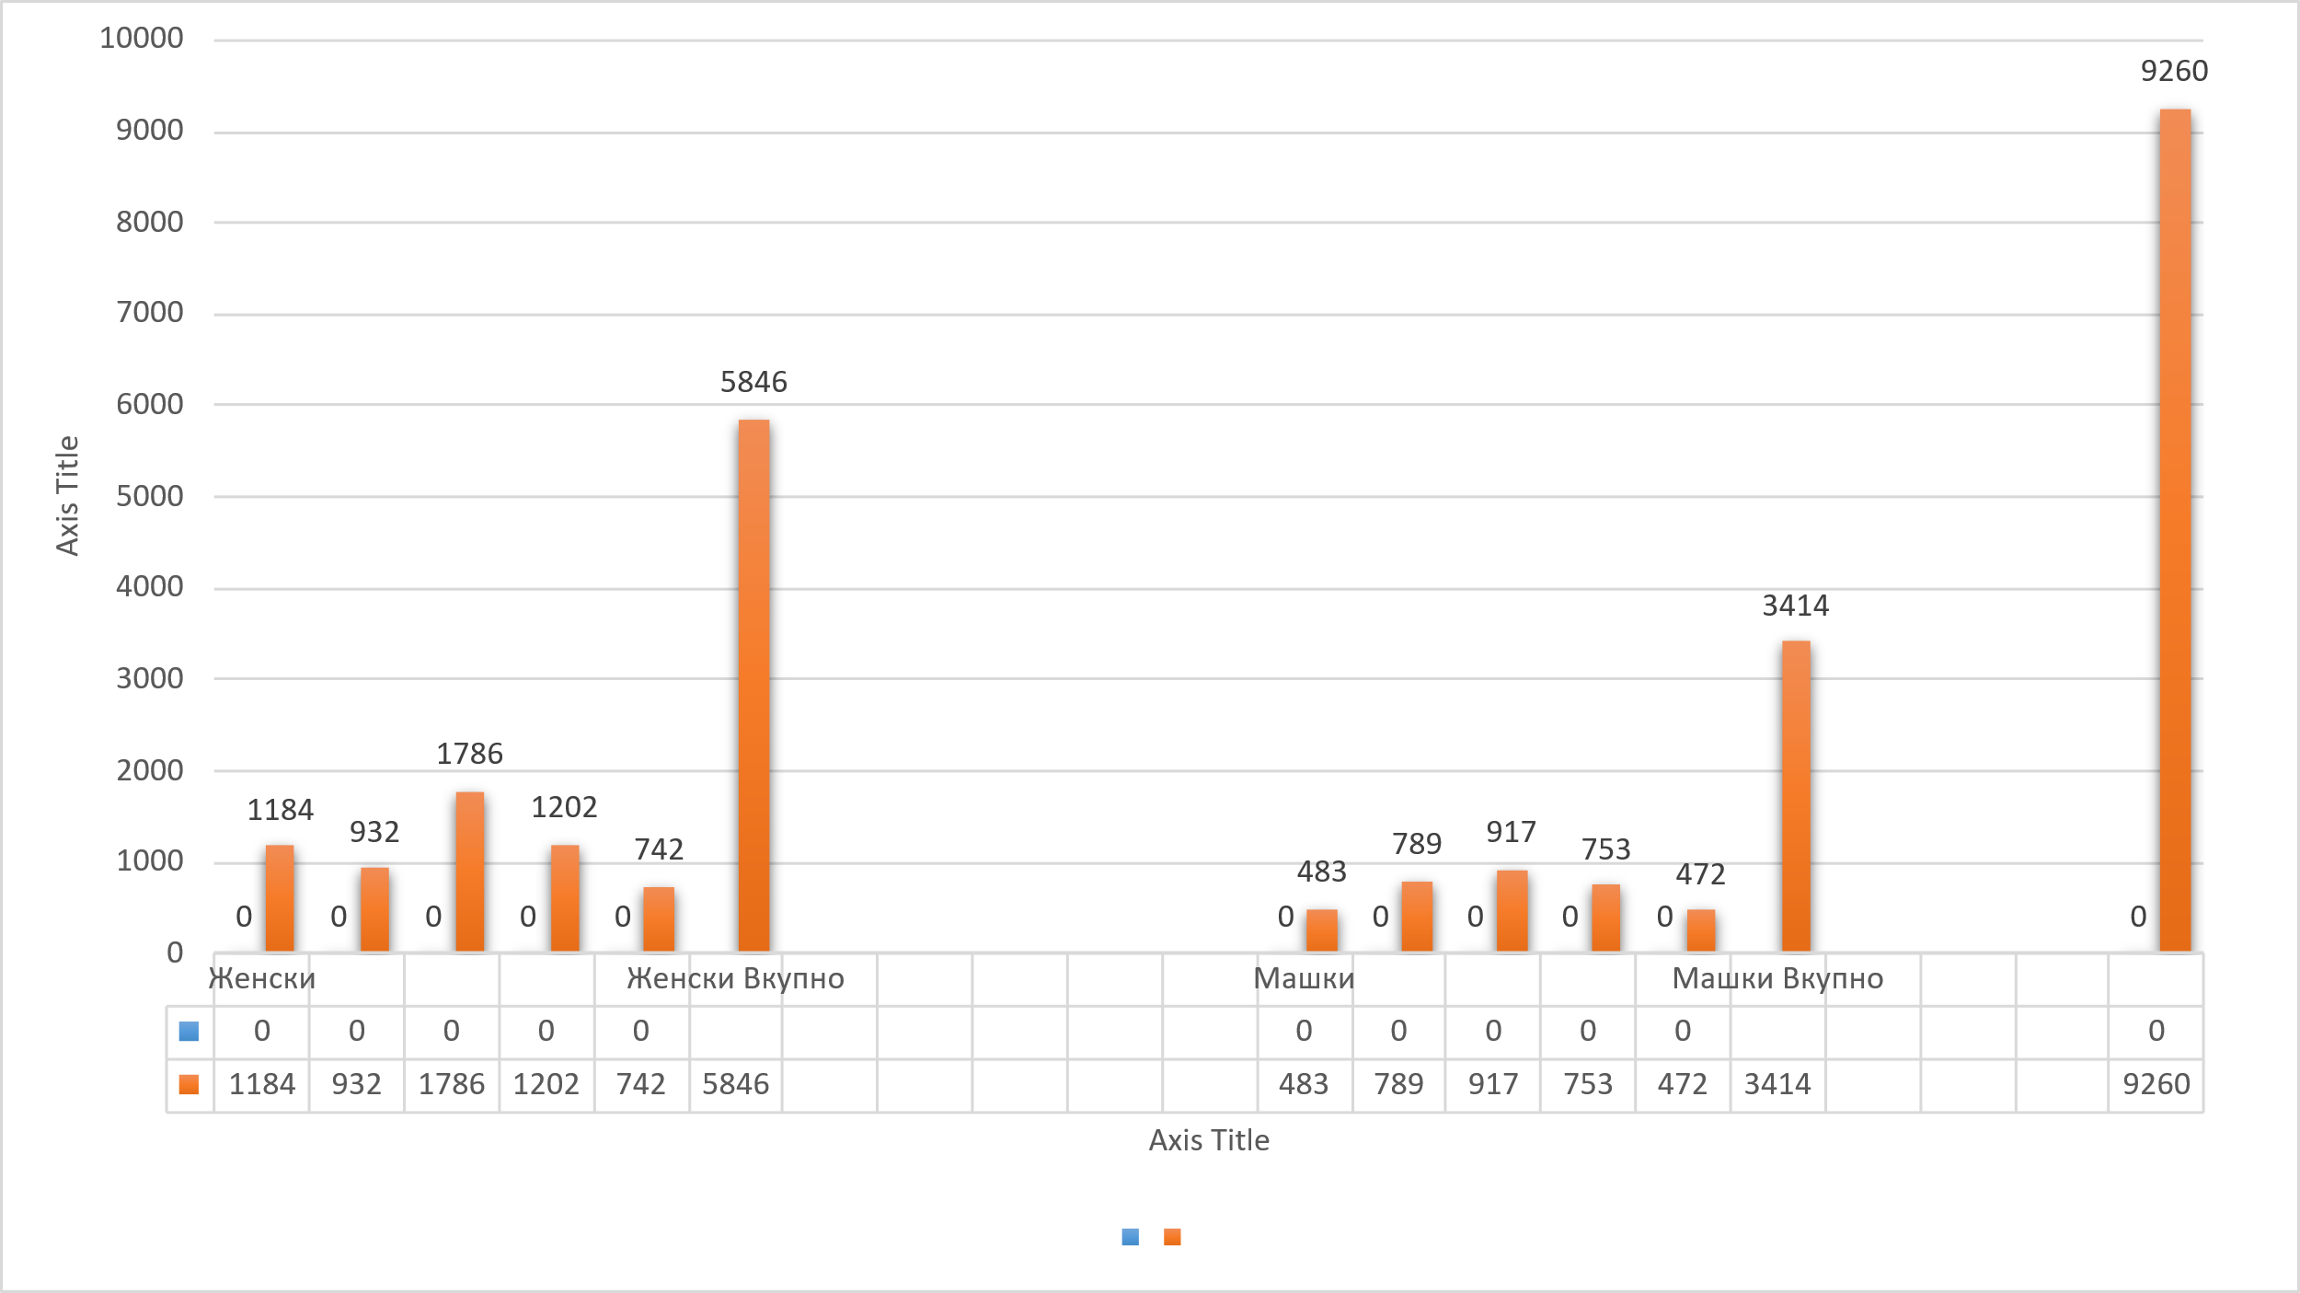
Women | <= 30 | 1184
 | >= 61 | 932
 | 31-40 | 1786
 | 41-50 | 1202
 | 51-60 | 742
Total Women |  | 5846
Men | <= 30 | 483
 | >= 61 | 789
 | 31-40 | 917
 | 41-50 | 753
 | 51-60 | 472
Total Men |  | 3414
 | Total Number | 9260

Slide 5
Do you have any numbers on the age of your medical chamber’s leadership (Executive
board, General Assembly etc.)?

Slide 6
Age Structure of the Members of the Chamber's Organizational Structure Number of Members
<= 30 1
31-40 25
41-50 43
51-60 39
>= 61 41

Slide 7
Are there concepts, either concrete or planned, to encourage young doctors to become involved in the work or bodies/committees of your medical chambers? If so, what are these concepts?

Slide 8
Within the chamber, a Commission for Issues of Residents and Young Doctors has been formed, consisting of 5 members, including one president. The purpose of this commission is to:
Monitor the current situations related to the position and work of young doctors.
Identify and address the problems that residents and young doctors face.
Provide proposals and initiatives to improve their status in the healthcare institutions where they practice their profession.
Be a voice and platform for advocating for the interests of this group within the chamber.
This concept represents an important step towards:
Active involvement of young people in decision-making.
Creating continuity in professional leadership.
Supporting the career development of new generations of doctors.

Slide 9
How many young people in your country are interested in studying medicine each year?
How many of these individuals end up studying medicine?
What role does your medical
chamber play in encouraging young people to study medicine?

Slide 10
Total Number of Graduated Students in the Past Five Years (According to data from the Chamber)
University Name | 2020 | 2021 | 2022 | 2023 | 2024
State University of Tetovo | 64 | 68 | 49 | 82 | 63
University "St. Cyril and Methodius" – Skopje | 202 | 202 | 219 | 257 | 198
Goce Delchev University, Shtip | 106 | 106 | 85 | 89 | 128
Total | 372 | 376 | 353 | 428 | 389

Slide 11
Total Number of Candidates Who Passed the Professional Exam
Year | Number of Candidates
2020 | 352
2021 | 406
2022 | 419
2023 | 425
2024 | 357
Total (last 5 years) | 1959

Slide 12
The Doctor’s Chamber of North Macedonia primarily has roles related to:
Licensing, regulation, and professional oversight of medical practice
Promoting professional development and continuous medical education (CME/CPD)
Specifically, when it comes to encouraging young people to choose medicine as a profession, there are no explicit programs or promotional campaigns targeted at high school students (as may be the case with some other professional organizations globally).
However, there is one notable initiative by the Chamber:
"Special Award for the Best Medical Students", named after Prim. Dr. Dimitar Ivanovski, the top student from the first generation of the Medical Faculty in Skopje.
The winners also receive vouchers to cover the costs of taking the professional exam
This award is an inspirational step – it recognizes academic excellence and can serve as encouragement.

Slide 13
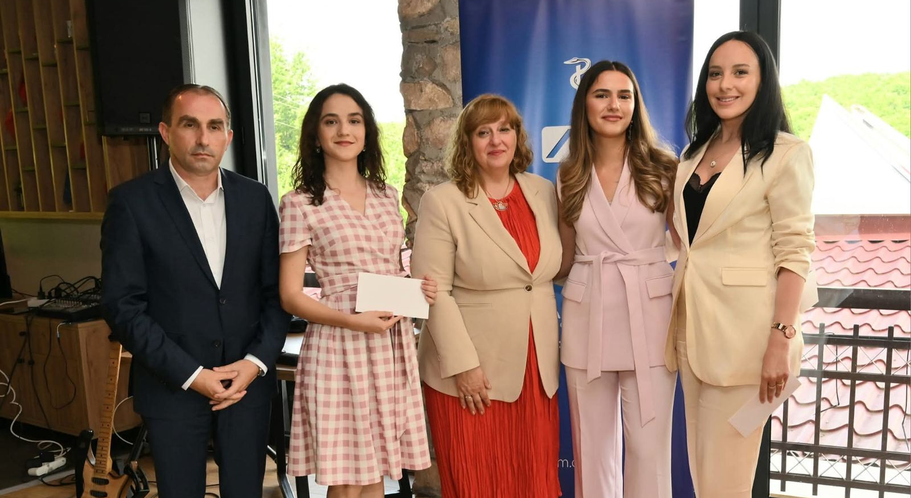

Slide 14

THANK YOU

