Slide 1
ZEVA national report 2025
Artificial intelligence
New generations in the medical chambers
Involvement in planning of medical personnel
Recognition of foreign diplomas: The roll of medical chamber
Ivan Raguž, Croatian Medical Chamber

Slide 2

1. Artificial intelligence

Slide 3
Artificial intelligence
no developed position on AI by the Chamber
not active topic in communication with members topic
still no plans for using AI to plan the deployment of medical personnel
existing plans to use AI chatbot for FAQ in communication with members

Slide 4

2. New generations in the medical chambers

Slide 5
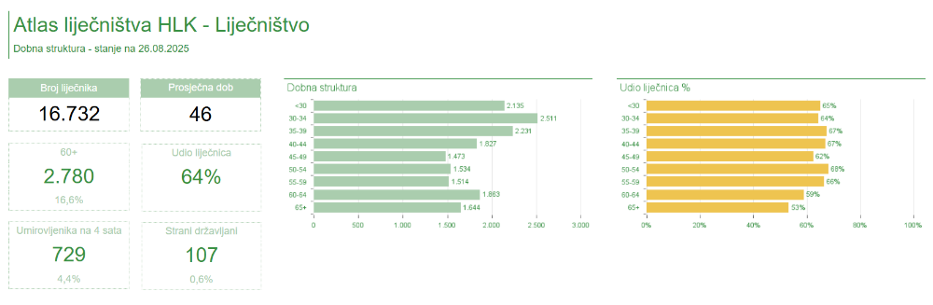
Age distribution
HLK | Mean age
Executive Committee | 52
Council | 50
General Assembly | 49

Slide 6
Committee for Young Doctors
permanent committee of CMC
since 2015.
mladi@hlk.hr
medical law courses – 1 per year at 4 Medical Universities
EJD

Slide 7
Young doctors benefits
yearly scholarship contest for international training
gift for birth of a child
stethoscope as welcome gift
housing needs support - interest on housing loans in the market
plans for Simulation Center for practical skills in the chamber

Slide 8
School of Medicine University of Zagreb
Year | Spots | Passed | Candidates
2025. | 300 | 460 (treshold 50,83%) | 942
2024. | 300 | 315 (treshold 55%) | 891
2023. | 300 | 402 | 920
2022. | 300 | 318 | 930
2021. | 300 | 274 | 967
2020. | 300 | 533 | 983
2019. | 300 | 560 | 1004
2018. | 300 | 542 | 1049

Slide 9

3. Involvement in planning of medical personnel

Slide 10
Main stakeholders
Ministry of Health - need for medical professionals per county
Croatian Health Insurance Fund (HZZO) - financial regulator - does not directly manage workforce planning
Croatian Institute of Public Health (HZJZ) - National Register of Health Professionals, collects data, delivers it to the Ministry
Counties (20) - active role in organizing employment and staff distribution in primary care and outpatient facilities
all public hospitals are in charge of the central state

Slide 11
Data collection
HZJZ register records information on all health workers —from appointments and system decisions to professional competencies
Data is used to monitor: workforce outflow, education, specializations, age structure, and geographic distribution

Slide 12
Weaknesses and challenges
rich databases, but their underutilized potential
systematic analyses of expected retirement age, workforce exits, or full-time equivalent (FTE) calculations are not regularly performed
no centralized workforce planning system—counties act in a fragmented way and do not always account for demographic changes or real health needs

Slide 13
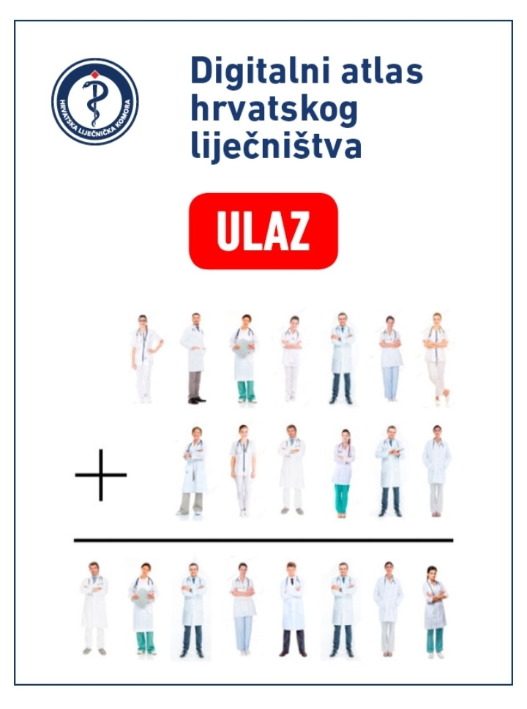
Chamber involvement
Digital Atlas of Croatian Physicians
https://atlas.hlk.hr/atlas/sidebar/sidebar.atlas.html

Slide 14

4. Recognition of foreign diplomas: the roll of medical chamber

Slide 15
Recognition process
Foreign professional qualifications for medical doctors - divided jurisdiction
automatic procedure
  CMC: university diploma
  general procedure
  Ministry of Health: medical specialist status

Slide 16
Automatic procedure
EU member states, European Economic Area (EEA) or Switzerland
skills acknowledged in accordance with EU DIRECTIVE 2005/36 EZ
or
non-EU medical qualification recognized in other EU member state
applicant has legally practiced in EU at least 3 of last 5 years

Slide 17
General procedure
compares foreign medical qualifications from non-EU countries with Croatian standards
if major differences are found (e.g., missing courses or more then 20% hours deficit per course)
applicant may be required to complete up to 3 years of adaptation or pass an aptitude test

Slide 18
Language skills
knowledge of Croatian language is required for practical reasons
no formal need to enclose proof of Croatian language skills

Slide 19
Thank you for your attention!
www.hlk.hr
ivan.raguz@hlk.hr

