Slide 1

National Report Austria
Mag. Katarzyna Bagińska
International Department of the Austrian Medical Chamber
IV. Recognition of foreign diplomas
ZEVA Symposium
Skopje, 4.-6. September 2025

Slide 2

Recognition of medical diplomas
In Austria, the Austrian Medical Chamber is the primary authority responsible for recognizing medical diplomas for doctors and ensuring their eligibility to practice in Austria.

Slide 3
Legal basis
Directive 2005/36/EC of the European Parliament and of the Council of 7 September 2005 on the recognition of professional qualifications
This directive was implemented in Austria through the Austrian Medical Act 1998 (ÄrzteG)

Slide 4
Automatic Recognition for EU/EEA
Medical qualifications obtained from EU/EEA member states or Switzerland are automatically recognized in Austria, provided they comply with the Directive 2005/36/EC.
The ÖÄK may request that applicants provide certificates issued by the competent authority stating that the training is in compliance with articles 23 – 30.

Slide 5
Art. 21 - Principle of automatic recognition
Each Member State shall recognise evidence of formal qualifications as doctor giving access to the professional activities of doctor with basic training and specialised doctor (…), listed in Annex V, points 5.1.1, 5.1.2, respectively, which satisfy the minimum training conditions referred to in Articles 24, 25, respectively, and shall, for the purposes of access to and pursuit of the professional activities, give such evidence the same effect on its territory as the evidence of formal qualifications which it itself issues.
Such evidence of formal qualifications must be issued by the competent bodies in the Member States and accompanied, where appropriate, by the certificates listed in Annex V, points 5.1.1, 5.1.2, respectively.

Slide 6
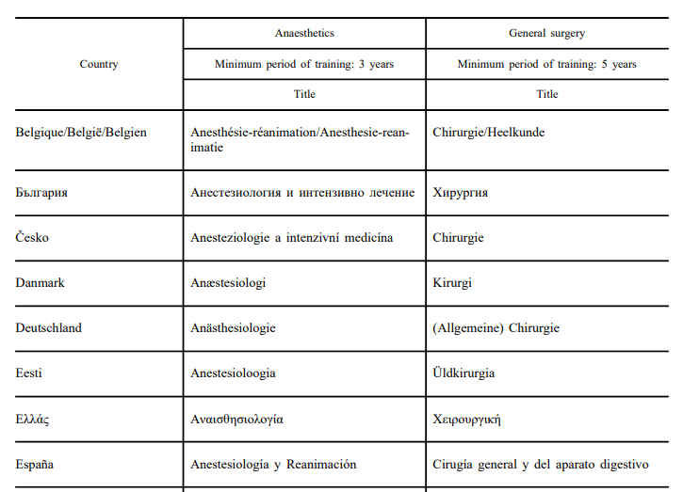
Annex V of the Directive lists the formal qualifications that must be submitted for the automatic recognition according to Art. 21.

Slide 7
Non-Automatic Recognition
Procedures based on the General system (non-automatic recognition)
Diplomas that do not comply with Articles 23–30 and are not listed in Annexes 5.1.1–5.1.3 can be recognized through the general system.

Slide 8
Medical qualifications obtained from EU/EEA member states or Switzerland that are not subject to automatic recognition, and qualifications from third countries that meet the requirements for non-automatic recognition are examined in terms of content as part of the non-automatic recognition procedure.
The ÖÄK may appoint a specialist expert to conduct the assessment.

Slide 9
Legal deadlines
Automatic recognition: decision within 3 months of complete documentation.
Non-automatic recognition: decision within 4 months of complete documentation.

Slide 10
Nostrifizierung
The procedure of Nostrifizierung (recognition of a university degree as equivalent to Austrian
standards) is within the competence of the medical universities (Vienna, Graz or Innsbruck).
In principle, foreign academic degrees are only recognised in Austria in accordance with § 90 of the Universities Act 2002 if recognition is absolutely necessary for the applicant to practise their profession or continue their education. This usually applies to holders of third-country diplomas that are not covered by the automatic recognition of diplomas.

Slide 11
Training undergone within the EEA or in Switzerland and in compliance
with the rules of the Directive 2005/36/EC
Training undergone within the EEA or in Switzerland and NOT in compliance
with the rules of the Directive 2005/36/EC
Training undergone in the third country+ recognised in an EEA State or
Switzerland + at least
3 years of actual and lawful professional experience on the territory of the Member State which
recognised the diploma
Training undergone outside the EEA/ Switzerland
Automatic recognition
Non-automatic recognition
Nostrification

Slide 12

Types of applications for recognition
1. By email to international@aerztekammer.at
2. Online application (via the website of the Austrian Medical Chamber)
3. In person, as part of the procedure for registration in the medical register

Slide 13
The role of the Austrian Medical Chamber in the recognition of foreign medical qualifications
Conducting the recognition procedure
Maintaining the list of doctors
Advising foreign doctors on the procedure for recognition and registration on the list of doctors
Contacting other national authorities, e.g. via the IMI system

Slide 14

Thank you for your attention!

