Slide 1

National Report Austria
Mag. Katarzyna Bagińska
International Department of the Austrian Medical Chamber
II. New generations in the medical chambers
ZEVA Symposium
Skopje, 4.-6. September 2025

Slide 2
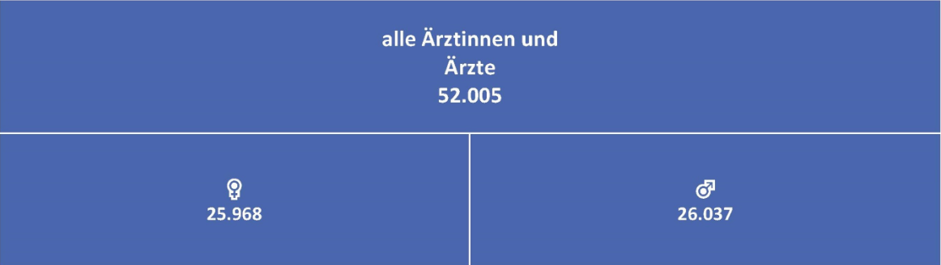
Doctors in numbers
As of 31 December 2024, Austria had a total of 52,005 registered physicians. Of these, 25,968 were women and 26,037 were men, showing a nearly balanced gender distribution.

Slide 3
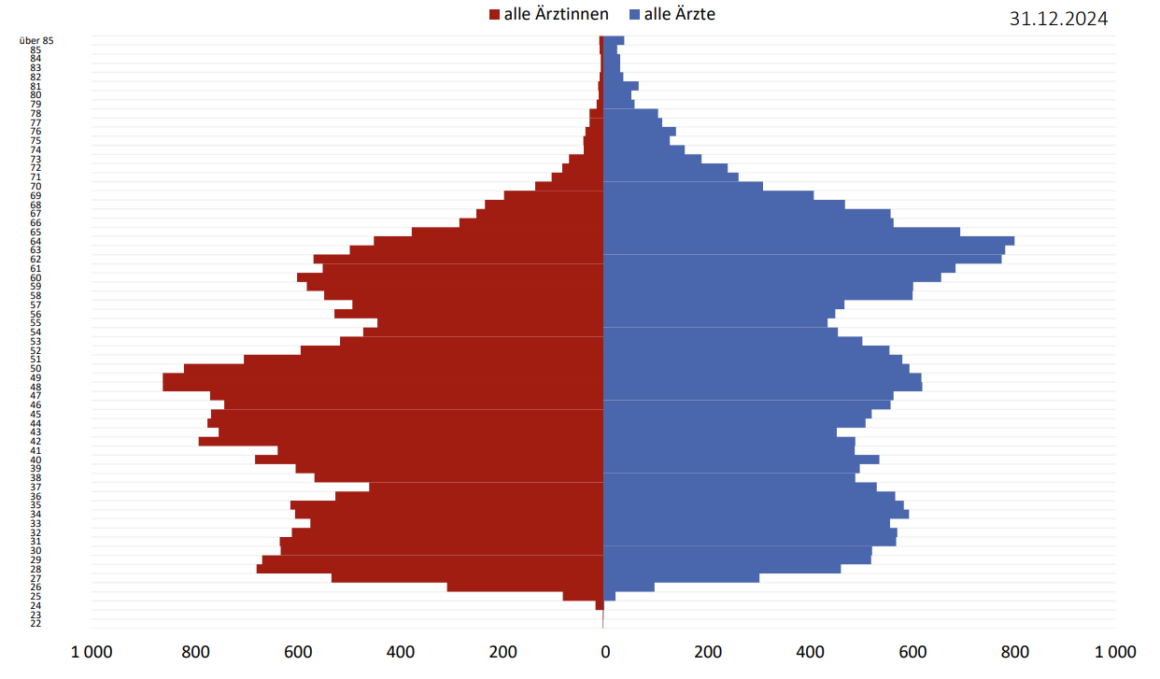
Female doctors (in red) and male doctors (in blue) by age

Slide 4
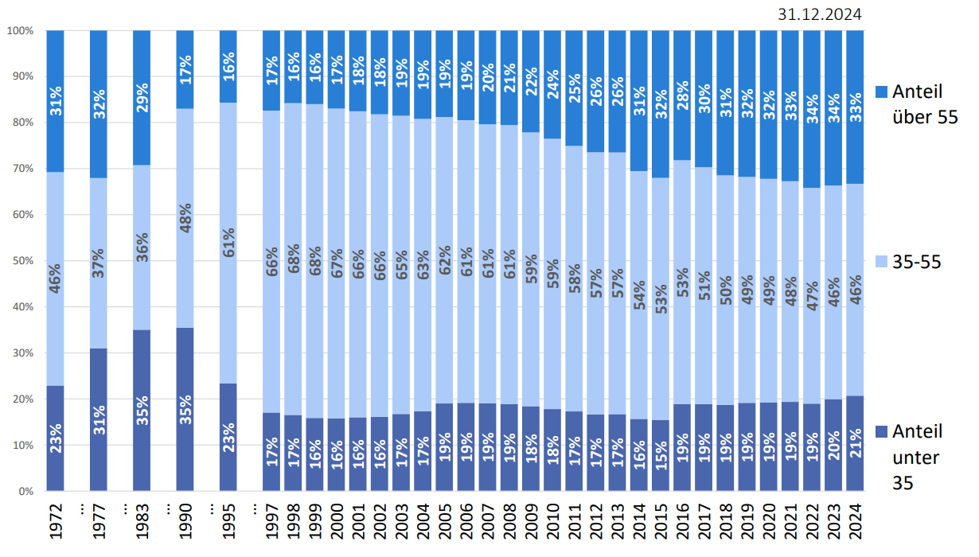
Aging of Austria’s Physician Workforce
Proportion of doctors under 35 and over 55 over time.

Slide 5
Representation of the young doctors within the Austrian Medical Chamber
The Referat für Jungmedizinerinnen und Jungmediziner (Department for Young Physicians) was established in June 2022 by the Austrian Medical Chamber. Its main purpose is to serve as a point of contact for young doctors in Austria, facilitating open dialogue and addressing their specific needs and concerns.

Slide 6
Each hospital may establish internal representatives for doctors in postgraduate training (Turnusärztevertreter). Their key role is to represent the interests and concerns of postgraduate doctors within their institutions and to communicate issues to senior leadership.
The Vienna Medical Chamber supports their work in various ways, including legal advice from the Chamber’s legal office and collaboration with the Chamber’s postgraduate medicine section (Sektion der Turnusärzt*innen)

Slide 7
The Federal Section of Doctors in Training (Bundessektion Turnusärzte) is the official body within the ÖÄK that represents doctors in training.
This section has its own elected representatives and a seat on the Board of the ÖÄK, ensuring that the views and needs of young doctors are included in the Chamber’s decision-making processes. Its role is to address issues such as working conditions, medical education, training quality, and career perspectives, and to advocate for improvements at the national level.

Slide 8
Number of applicants for medical studies in Austria
Each year, a significant number of young people in Austria express interest in studying medicine by participating in the MedAT entrance examination.
In 2025, a total of 15,668 individuals registered for the MedAT. Only 1,900 study places were available across all participating universities (Vienna, Graz, Innsbruck, Linz).

Slide 9

In Austria, a quota system was introduced in favour of domestic medical students in order to reduce the influx of a large number of high school graduates from other countries (especially Germany).

Slide 10

Currently, 75% of places at the four state universities are reserved for Austrian high school graduates. The next 20% of the places are then divided between other Austrian applicants who were not admitted in the first round and to EU applicants. 5% are open to all other applicants, regardless of nationality.

Slide 11
Challenges despite the high number of medical graduates
Around one third of medical students who complete their studies in Austria do not work as doctors after graduation.
There are difficulties in filling positions in the health insurance system, even though there is no quantitative shortage of doctors in Austria.

Slide 12
Scholarship programs
In Austria, several scholarship programs support medical students who commit to working in publicly funded healthcare settings after completing their studies. These initiatives aim to address regional shortages of medical professionals and ensure the long-term sustainability of the healthcare system.

Slide 13

Thank you for your attention!

